Slide 1



Library Management System: DEPI Project
Our team of five interns developed a comprehensive Library Management System during a 159-hour .NET web development internship at DEPI. The system streamlines library operations and enhances user experience.
2 Contributors

Slide 2





Our Team
Mohamed Mohsen
Maxim Mamdouh
Khaled Elashry
Responsible for project coordination, authentication, and system integration.
Developed controllers and business logic, including rules for borrowing and penalties.
Designed the database, implemented Entity Framework models, and handled CRUD operations.
Enjy Boushra
Shehab El-Din Ashraf
Developed unit and integration tests and documented the project structure.
Created the UI using Razor views and ensured front-end responsiveness.

Slide 3
Benefits of a Library Management System
Streamlines Operations: Automates key library processes like borrowing, returns, and inventory management, improving efficiency.
Enhanced User Experience: Provides a seamless and intuitive interface for patrons to search, borrow, and manage their library activities.

Slide 4

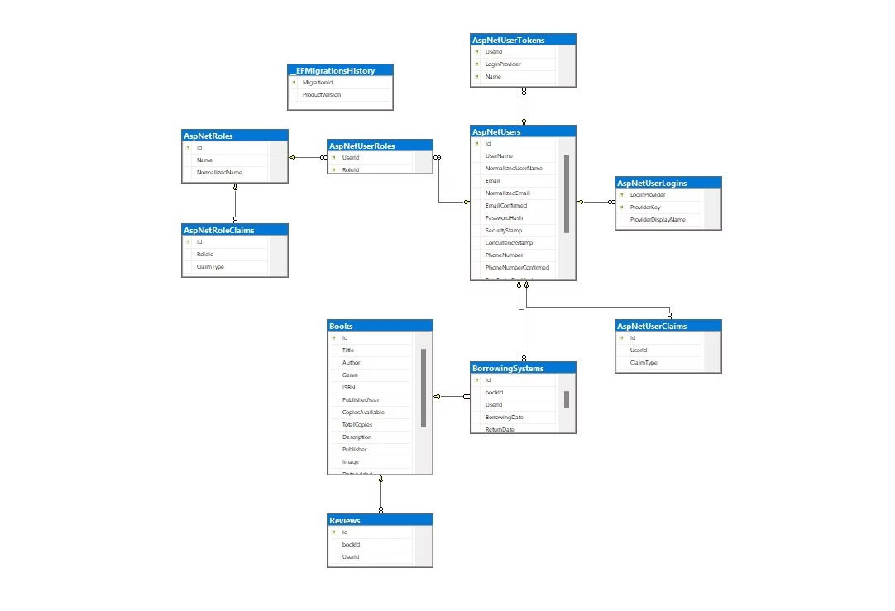
Database Design and Implementation
The library management system's database was designed to efficiently store and manage all library-related data. Khaled Elashry led the database implementation, using Entity Framework to create models that represent key entities like books, patrons, and borrowing records.
The database schema ensures data integrity and supports the system's functionalities, such as borrowing books, tracking patron history, and generating reports. Regular backups and security measures are in place to protect the sensitive library data.

Slide 5

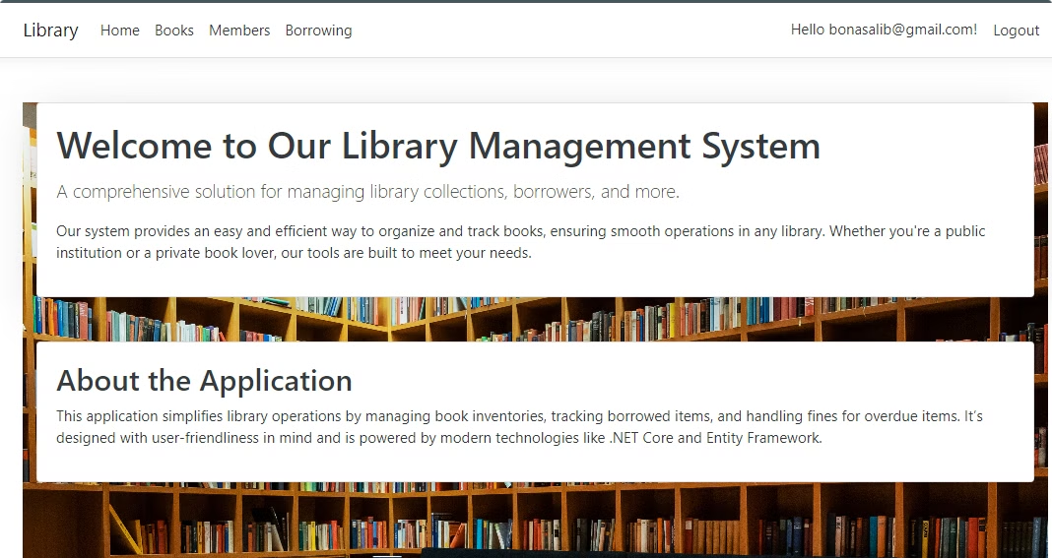
Home Page
The intuitive home page serves as the entry point to our comprehensive Library Management System. It provides an overview of the system's features and guides users to key functionalities.

Slide 6

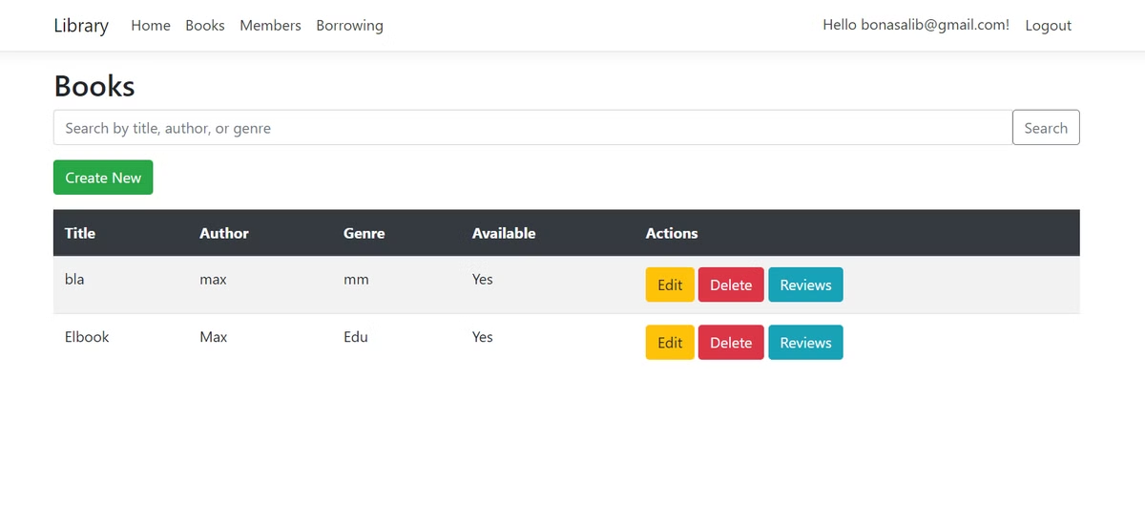
Books Page
Inventory Management
Book Operations
Real-time Updates
Librarians can view the entire book collection at a glance. They can easily search for specific book.
Adding new books, updating information, and removing outdated titles is straightforward. The interface is user-friendly and intuitive.
Changes to the inventory are reflected immediately. This ensures accurate information for both staff and library members.

Slide 7

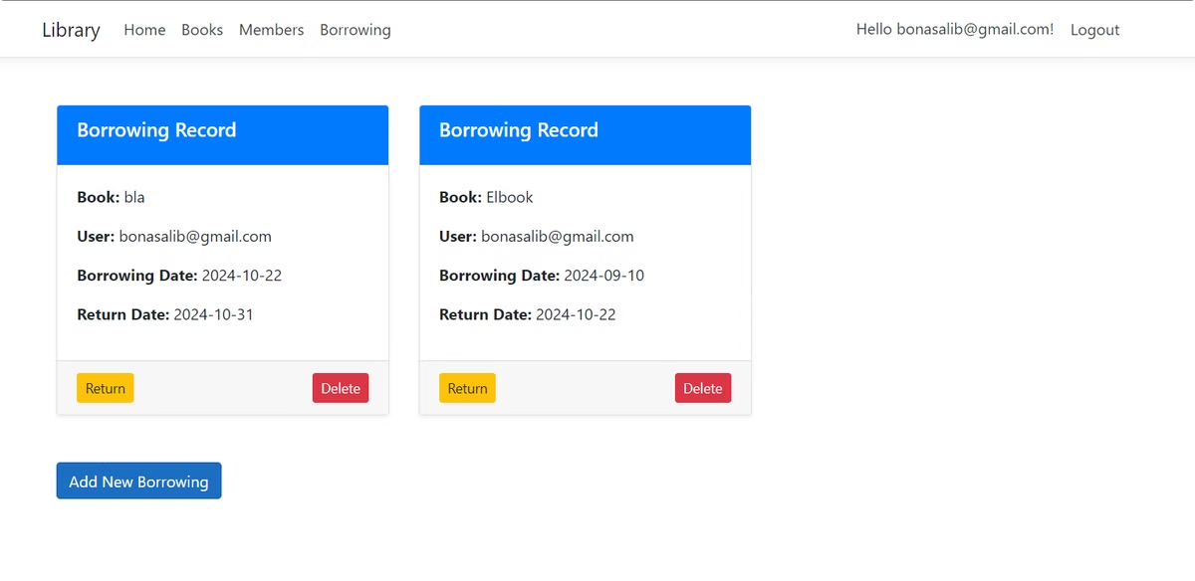
Borrowing Records

Slide 8

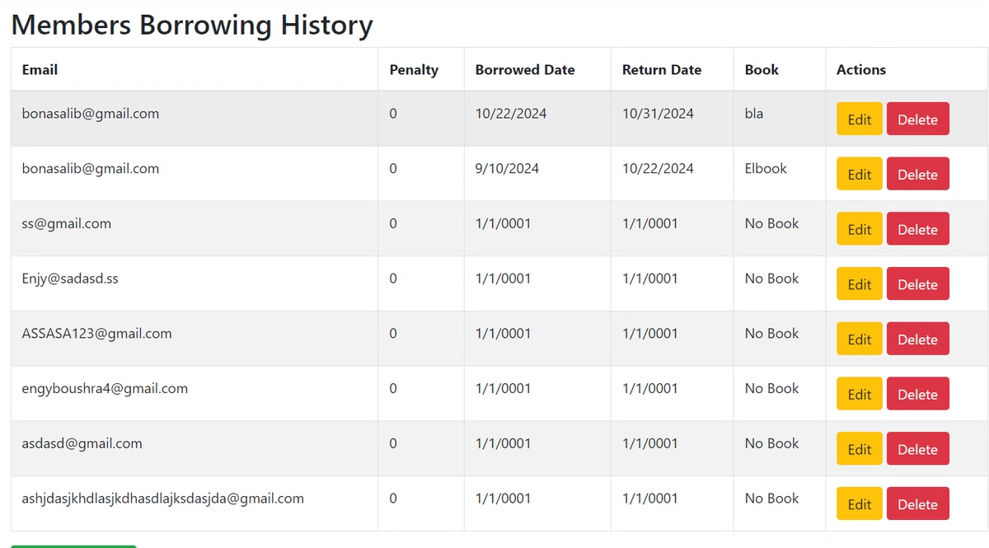
Borrowing List Page
Member Profiles
View detailed user information, including borrowing history, current loans, and membership details.
Penalty Tracking
Automatically calculates and displays penalties for overdue books, ensuring fair and consistent enforcement of library policies.
Activity Monitoring
Track borrowing patterns, return frequency, and rule violations to optimize library services and promote responsible use of resources.

Slide 9


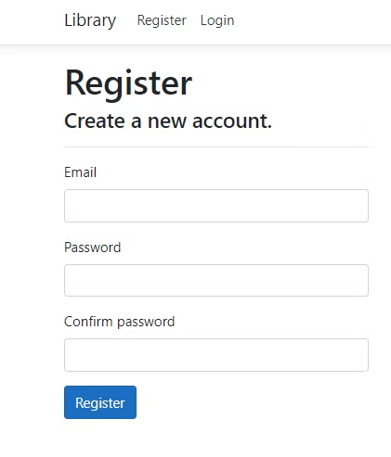


Security Features
Restricted Access
Unauthorized users are redirected to the login page when attempting to access restricted areas.
User Authentication
Robust login system ensures only registered users can access the system. Different access levels are implemented.
Data Protection
User data and borrowing records are securely stored and protected from unauthorized access.

Slide 10

Project Timeline
Week 1: Initial Setup and Database Design
Set up ASP.NET Core with Entity Framework and SQL Server. Design the database schema for books, checkouts, returns, and penalties. Implement a basic book listing page for librarians. Set up user authentication for librarians.
Week 2: Checkout, Returns, and Penalty Calculation
Implement book checkout and return features with due dates. Automatically calculate penalties for overdue books. Test the checkout, return, and penalty systems.
Deliverables: Project setup, database schema, book listing page, and user authentication.
Deliverables: Functional checkout/return system, penalty calculation, and tested features.

Slide 11

Project Timeline
Week 3: Book Management and Search
Develop a comprehensive book management system for librarians to add, edit, and delete book records. Implement a robust search functionality to allow users to find books by title, author, or genre.
Week 4: Final Testing, UI Enhancements, and Deployment
Refine the user interface for optimal responsiveness and usability. Conduct thorough testing across all system features. Deploy the library management system to a hosting platform and complete the project documentation.

Slide 12

Thank You for Using Our Library Management System
We appreciate your patronage and hope you found our library's services helpful. Please let us know if you have any feedback or suggestions for improvement.

